Slide 1
Introduction to Computer Science and Programming
Labo 12 – C++ Arrays (and Functions)
Laboratory 12, March 5, 2026
Filippo Ricca and Muhammad Mohsin
DIBRIS, University of Genova

Slide 2
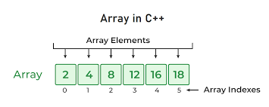
Today…
Today's lab is dedicated to arrays and functions
Exercise 1: Sum of an array and print its contents
Exercise 2: Count Occurrences of a Given Number in Array
Exercise 3: Frequent Element in Array
Exercise 4: Searching for an element in an array
Exercise 5: Selection sort
All the C++ program must be delivered on Aulaweb!
At the beginning of the April, there will be graded lab, where you will be required to demonstrate your skills with the contents, we covered so far including functions, arrays and strings.
Notes:
Today we will do some simple exercises on using the computer

Slide 3
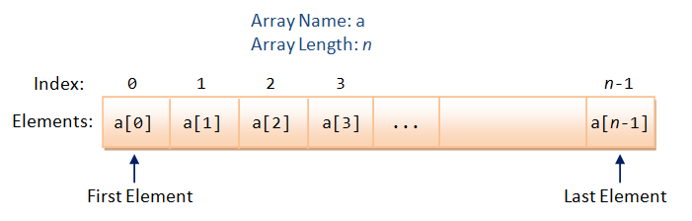
Array
An array is a sequence of objects of the same type that occupy a contiguous area of memory.

Slide 4
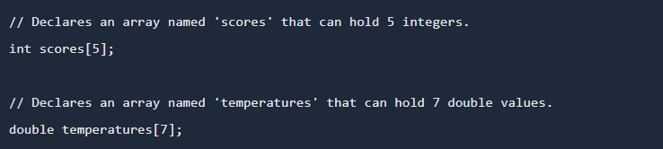
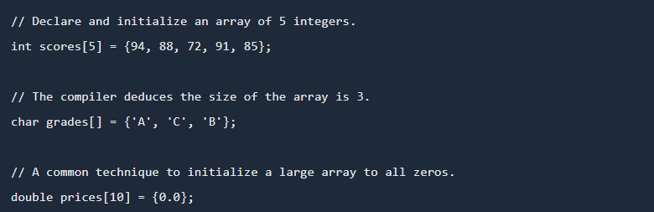
Declaring and Initializing arrays

Slide 5
Exercise 1: Sum of an Array and Print Array's Contents (Simple)
In this exercise, you will implement a C++ program that computes the sum of the elements of an array and prints its contents.
Requirements:
Write a function int sum(int arr[], int size) that:
Takes an integer array and its size as input
Calculates the sum of all elements
Returns the sum
Write a function void print(int arr[], int size) that:
Prints the array in this format:
For example : {1,2,3,4}
In main():
Ask the user how many elements the array has
Ask the user to enter the elements
Call print() to display the array
Call sum() to calculate the total
Notes:
#include <iostream>
using namespace std;
// Function to calculate the sum of array elements
int sum(int arr[], int size) {
int total = 0;
for (int i = 0; i < size; i++) {
total += arr[i];
}
return total;
}
// Function to print the array in the specified format
void print(int arr[], int size) {
cout << "{";
for (int i = 0; i < size; i++) {
cout << arr[i];
if (i < size - 1) {
cout << ",";
}
}
cout << "}" << endl;
}
int main() {
int size;
// Ask user for the number of elements
cout << "How many elements does the array have? ";
cin >> size;
// Create array with the specified size
int arr[size];
// Ask user to enter the elements
cout << "Enter " << size << " elements: ";
for (int i = 0; i < size; i++) {
cin >> arr[i];
}
// Print the array
cout << "Array: ";
print(arr, size);
// Calculate and display the sum
int total = sum(arr, size);
cout << "Sum of array elements: " << total << endl;
return 0;
}

Slide 6
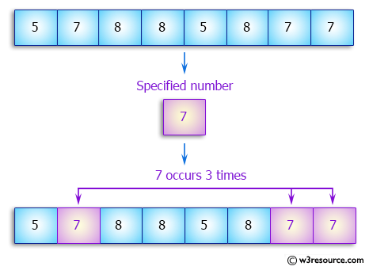
Exercise 2: Count Occurrences of a Given Number in Array (Simple)
Write a C++ program to count the number of occurrences of a given number in a array of integers.
Notes:
#include <iostream>
using namespace std;
// Function to count occurrences of a target number in an array
int countOccurrences(int arr[], int size, int target) {
int count = 0;
for (int i = 0; i < size; i++) {
if (arr[i] == target) {
count++;
}
}
return count;
}
// Function to print the array
void printArray(int arr[], int size) {
cout << "[";
for (int i = 0; i < size; i++) {
cout << arr[i];
if (i < size - 1) {
cout << ", ";
}
}
cout << "]" << endl;
}
int main() {
int size;
// Get array size from user
cout << "Enter the number of elements in the array: ";
cin >> size;
// Create array
int arr[size];
// Get array elements from user
cout << "Enter " << size << " integers: ";
for (int i = 0; i < size; i++) {
cin >> arr[i];
}
// Display the array
cout << "Array: ";
printArray(arr, size);
// Get the number to search for
int target;
cout << "Enter the number to count occurrences of: ";
cin >> target;
// Count occurrences
int occurrences = countOccurrences(arr, size, target);
// Display result
cout << "The number " << target << " appears " << occurrences
<< " time" << (occurrences != 1 ? "s" : "") << " in the array." << endl;
return 0;
}

Slide 7
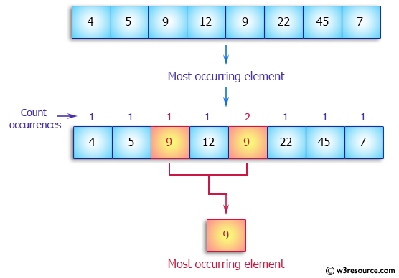
Exercise 3: Frequent Element in Array (Simple)
Write a C++ program to find the most frequent element in an array of integers.
Notes:
#include<iostream>
using namespace std;
// Function to find the most occurred number(s) in the array
void most_occurred_number(int nums[], int size)
{
if (size == 0) {
cout << "\nArray is empty!" << endl;
return;
}
int max_count = 0;
// First pass: find maximum occurrence count
for (int i = 0; i < size; i++)
{
int count = 1;
// Count occurrences of nums[i]
for (int j = i + 1; j < size; j++)
{
if (nums[i] == nums[j])
count++;
}
if (count > max_count)
max_count = count;
}
// Second pass: output numbers with max_count occurrences (without duplicates)
cout << "\nMost occurred number";
// Check if there are multiple numbers with max_count
int multiple_count = 0;
for (int i = 0; i < size; i++)
{
// Check if this number should be printed (first occurrence only)
bool already_printed = false;
for (int k = 0; k < i; k++)
{
if (nums[k] == nums[i])
{
already_printed = true;
break;
}
}
if (!already_printed)
{
int count = 1;
for (int j = i + 1; j < size; j++)
{
if (nums[i] == nums[j])
count++;
}
if (count == max_count)
multiple_count++;
}
}
if (multiple_count > 1) cout << "s";
cout << ": ";
// Actually print the numbers
bool first = true;
for (int i = 0; i < size; i++)
{
// Check if this number should be printed (first occurrence only)
bool already_printed = false;
for (int k = 0; k < i; k++)
{
if (nums[k] == nums[i])
{
already_printed = true;
break;
}
}
if (!already_printed)
{
int count = 1;
for (int j = i + 1; j < size; j++)
{
if (nums[i] == nums[j])
count++;
}
if (count == max_count)
{
if (!first) cout << ", ";
cout << nums[i];
first = false;
}
}
}
cout << " (appears " << max_count << " time";
if (max_count > 1) cout << "s";
cout << ")" << endl;
}
int main()
{
int nums[] = {4, 5, 9, 12, 9, 22, 45, 7};
int n = sizeof(nums) / sizeof(nums[0]);
cout << "Original array: ";
for (int i = 0; i < n; i++)
cout << nums[i] << " ";
most_occurred_number(nums, n);
return 0;
}

Slide 8
Exercise 4: Searching for an Element in an Array
In this exercise, you will implement a C++ program to search for an integer in an array. You will need to write a function to perform the search and check if the element exists in the array
Requirements:
Write a function searchElement(int arr[], int size, int target) that:
Takes an array of integers arr[], its size size, and a target integer as input
Searches for the target element in the array
If the element is found, return its index
If the element is not found, return -1
The program should ask the user to insert the elements of the array
After the array is created, ask the user for the element they want to search for
Invoke the function searchElement()
Display the result:
If the element is found, display the index where it was found
If the element is not found, display "Element not found"
Notes:
#include <iostream>
using namespace std;
// Function to search for an element in the array
int searchElement(int arr[], int size, int target) {
for (int i = 0; i < size; i++) {
if (arr[i] == target) {
return i; // Element found, return index
}
}
return -1; // Element not found, return -1
}
int main() {
int size, target;
// Input array size
cout << "Enter the size of the array: ";
cin >> size;
int arr[size];
// Input array elements
cout << "Enter the elements of the array:" << endl;
for (int i = 0; i < size; i++) {
cin >> arr[i];
}
// Input target element to search
cout << "Enter the element to search for: ";
cin >> target;
// Call the search function
int result = searchElement(arr, size, target);
// Display the result
if (result != -1) {
cout << "Element " << target << " found at index " << result << endl;
} else {
cout << "Element not found." << endl;
}
return 0;
}

Slide 9
Always avoid shortcuts!
Problem Solving Phase
Problem
Reasoning
at level of
Pseudocode!
Algorithm
Implementation Phase
Program/Code
Shortcut
One might be tempted to skip the problem-solving phase and jump straight into writing the program. This is a big mistake!!!

Slide 10
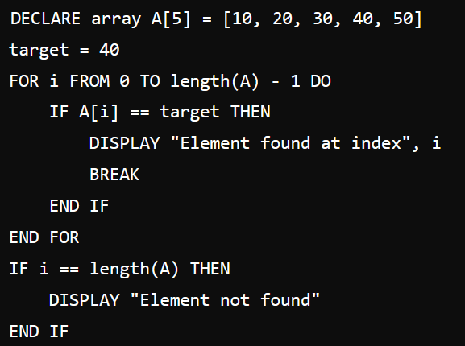
Pseudocode
We had already seen the pseudocode for performing a search in an array in lesson 4, I am presenting it to you again
It is necessary to go through all the elements of the array!
Pay attention: What you have to do is a bit different!
Notes:
#include <iostream>
using namespace std;
// Function to search for an element in the array
int searchElement(int arr[], int size, int target) {
for (int i = 0; i < size; i++) {
if (arr[i] == target) {
return i; // Element found, return index
}
}
return -1; // Element not found, return -1
}
int main() {
int size, target;
// Input array size
cout << "Enter the size of the array: ";
cin >> size;
int arr[size];
// Input array elements
cout << "Enter the elements of the array:" << endl;
for (int i = 0; i < size; i++) {
cin >> arr[i];
}
// Input target element to search
cout << "Enter the element to search for: ";
cin >> target;
// Call the search function
int result = searchElement(arr, size, target);
// Display the result
if (result != -1) {
cout << "Element " << target << " found at index " << result << endl;
} else {
cout << "Element not found." << endl;
}
return 0;
}

Slide 11
Exercise 5: Selection sort
Write a C++ function able to implement the Selection sort algorithm of integers numbers
Alternative algorithm to Bubble sort
Selection Sort is a comparison-based sorting algorithm
It sorts an array by repeatedly selecting the smallest (or largest) element from the unsorted portion and swapping it with the first unsorted element. This process continues until the entire array is sorted
Notes:
#include<iostream>
using namespace std;
// Function to perform Selection Sort (sorts in ascending order)
void selectionSort(int arr[], int size) {
for (int i = 0; i < size - 1; i++) {
// Find the minimum element in unsorted portion
int minIndex = i;
for (int j = i + 1; j < size; j++) {
if (arr[j] < arr[minIndex]) {
minIndex = j; // Update index of minimum element
}
}
// Swap the found minimum element with the first element
if (minIndex != i) {
int temp = arr[i];
arr[i] = arr[minIndex];
arr[minIndex] = temp;
}
}
}
// Function to print array elements
void printArray(int arr[], int size) {
cout << "[";
for (int i = 0; i < size; i++) {
cout << arr[i];
if (i < size - 1) cout << ", ";
}
cout << "]" << endl;
}
int main() {
// Test array
int arr[] = {64, 25, 12, 22, 11};
int size = sizeof(arr) / sizeof(arr[0]);
cout << "Original array: ";
printArray(arr, size);
selectionSort(arr, size);
cout << "Sorted array: ";
printArray(arr, size);
return 0;
}

Slide 12
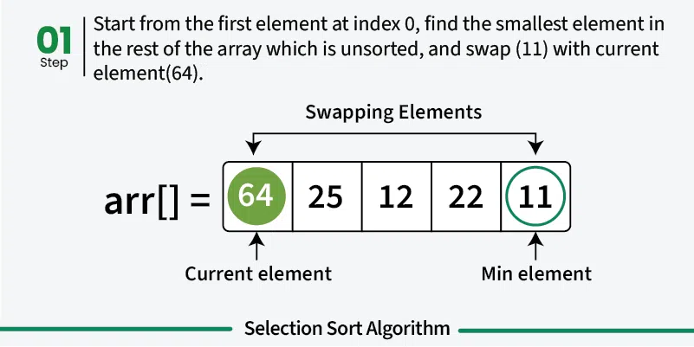
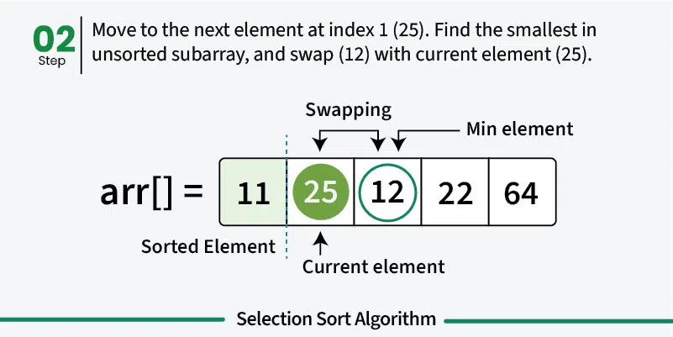
Idea of the algorithm: Example

Slide 13
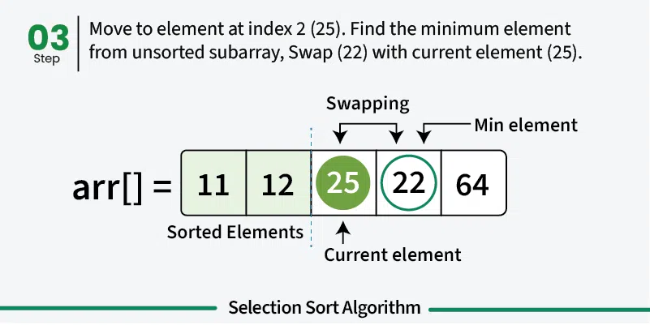
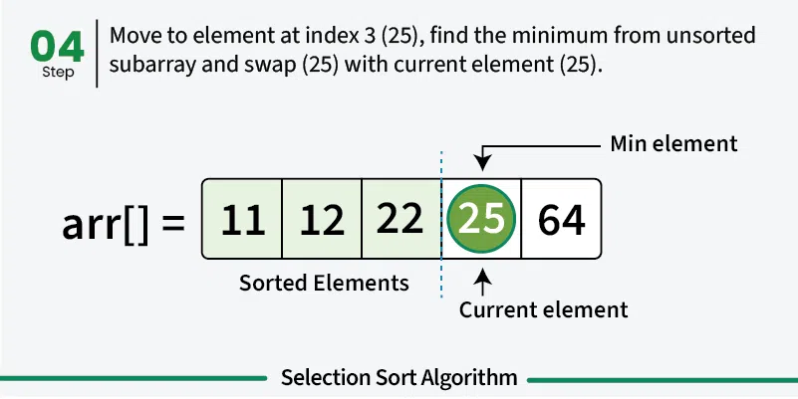
Idea of the algorithm: Example
And so on …

Slide 14
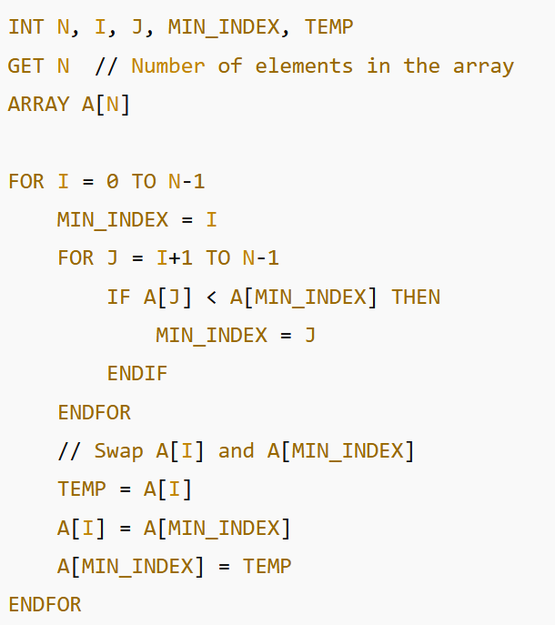
Pseudocode
“First, we find the smallest element and swap it with the first element of the array (position 0). This way we get the smallest element at its correct position”
“Then, we find the smallest among remaining elements (or second smallest) and swap it with the second element”
“We keep doing this until we get all elements moved to correct position”
Version 1
Version 2

Slide 15

Now, it’s your turn
From pseudocode to C++:
You have to implement the pseudocode in a function and create a main that declare and define an array and pass to the function the array. Then, the main has to write the ordered array

Slide 16
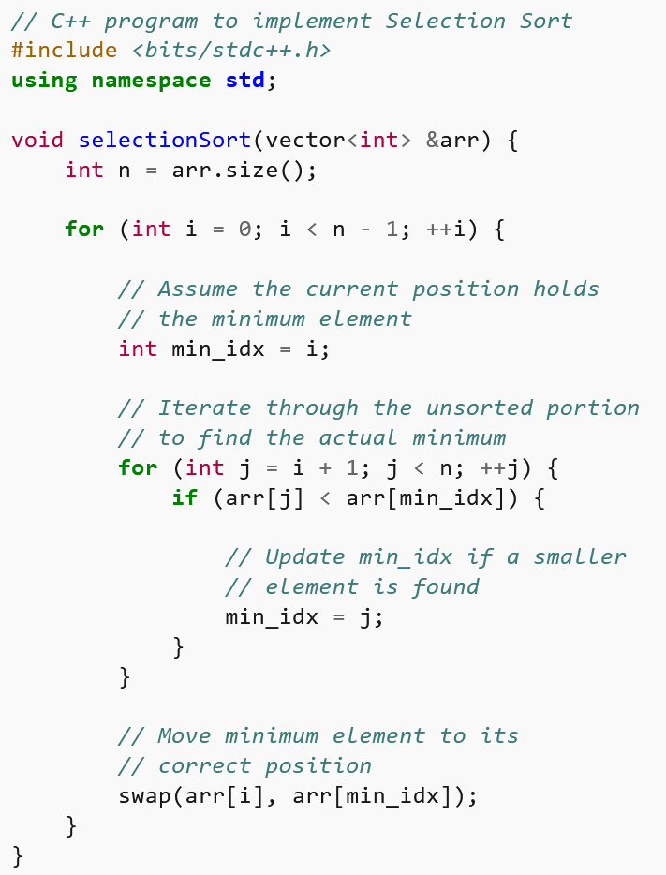
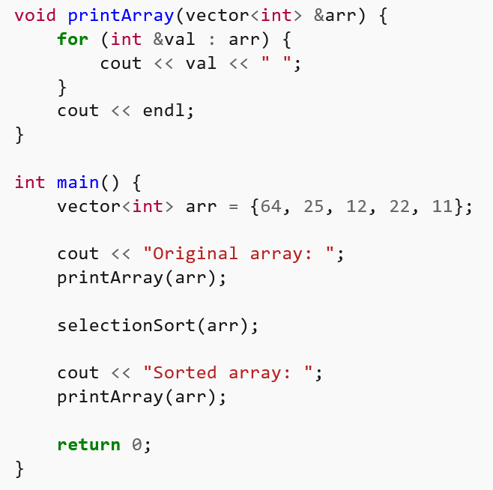
C++ code
Notes:
https://www.geeksforgeeks.org/selection-sort-algorithm-2/

Slide 17

Exercise 6: Implement a Stack using an Array in C++
Objective: In this exercise, you will implement a stack data structure using an array in C++. You will need to write the necessary functions to perform basic stack operations
Requirements:
Implement a stack with an array that supports the following operations:
push(value): Adds an element to the top of the stack
pop(): Removes the element from the top of the stack
peek(): Returns the element at the top of the stack without removing it
isEmpty(): Returns true if the stack is empty, otherwise false
size(): Returns the current size (number of elements) of the stack

Slide 18
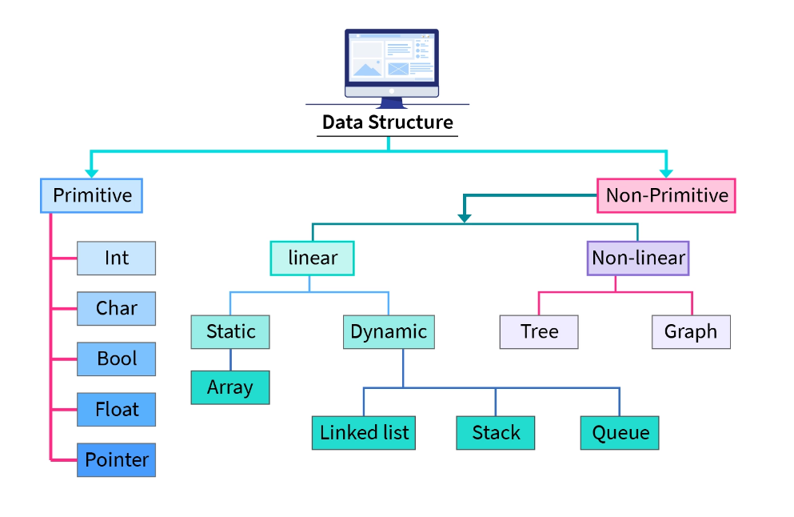
Slide taken from lesson 4

Slide 19
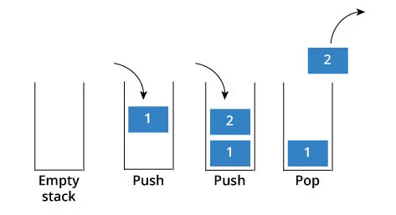
Stack
A stack is a data structure where items can only be added or removed from one end
A stack is a LIFO (Last-In/First-Out) data structure
Operations:
Push: adds an item to the top
Pop: removes the top item and returns it
Peek: returns the top item without removing it
IsEmpty: checks if the stack is empty
Size: returns the number of items in the stack

Slide 20
Suggestions
Use an array to store the elements of the stack and an integer to keep track of the current top of the stack
You can call them stack and top
Implement error handling for cases such as:
Popping from an empty stack
Pushing to a full stack
Avoid ‘Out of bound error’!
Write a main function to test the stack with the following sample operations:
Push some values onto the stack
Pop an element from the stack
Peek at the top element
Check if the stack is empty or full
Display the size of the stack

Slide 21
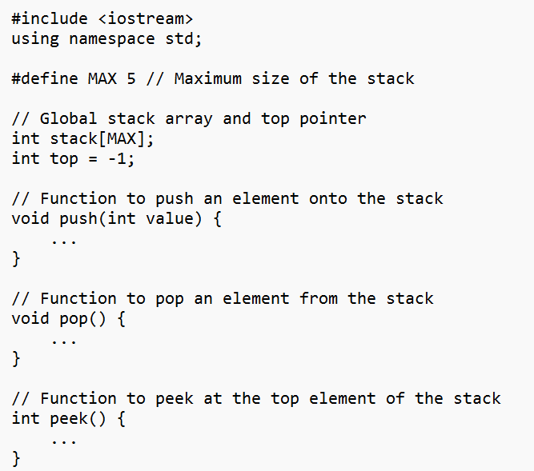
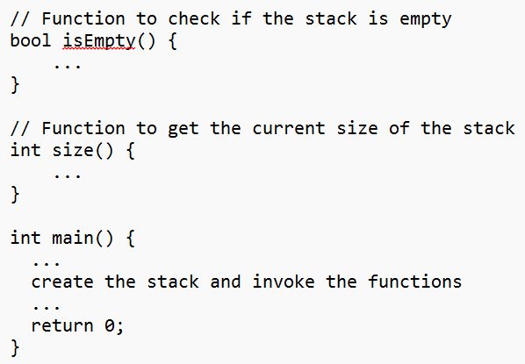
Skeleton of the program
Notes:
#include <iostream>
using namespace std;
#define MAX 5 // Maximum size of the stack
// Global stack array and top pointer
int stack[MAX];
int top = -1;
// Function to push an element onto the stack
void push(int value) {
if (top == MAX - 1) {
cout << "Stack is full. Cannot push " << value << endl;
} else {
stack[++top] = value;
cout << value << " pushed to stack" << endl;
}
}
// Function to pop an element from the stack
void pop() {
if (top == -1) {
cout << "Stack is empty. Cannot pop." << endl;
} else {
cout << stack[top--] << " popped from stack" << endl;
}
}
// Function to peek at the top element of the stack
int peek() {
if (top == -1) {
cout << "Stack is empty." << endl;
return -1; // Return an invalid value to indicate empty stack
}
return stack[top];
}
// Function to check if the stack is empty
bool isEmpty() {
return top == -1;
}
// Function to check if the stack is full
bool isFull() {
return top == MAX - 1;
}
// Function to get the current size of the stack
int size() {
return top + 1;
}
int main() {
push(10); // Push 10
push(20); // Push 20
push(30); // Push 30
push(40); // Push 40
push(50); // Push 50
// Attempt to push when the stack is full
push(60); // This should show an error message
// Peek at the top element
cout << "Top element is: " << peek() << endl;
pop(); // Pop top element
pop(); // Pop next element
cout << "Top element after pops: " << peek() << endl;
cout << "Stack size: " << size() << endl;
// Check if the stack is empty
if (isEmpty()) {
cout << "Stack is empty." << endl;
} else {
cout << "Stack is not empty." << endl;
}
// Check if the stack is full
if (isFull()) {
cout << "Stack is full." << endl;
} else {
cout << "Stack is not full." << endl;
}
return 0;
}

Slide 22
Now, it’s your turn
From SKeleton to C++

